Slide 1
Google analytics
By – Digisha Singhal

Slide 2
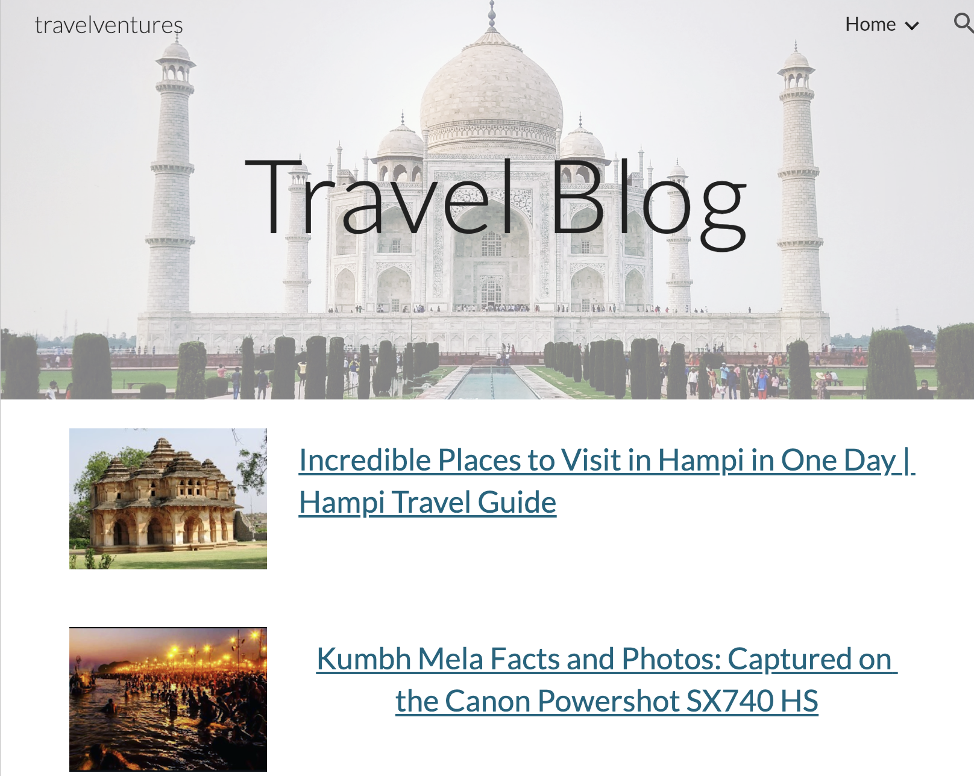
Travel Blog
https://sites.google.com/view/travelventures/home
It has a total of 3 pages
Home page
Adventure sports
Travel hacks

Slide 3
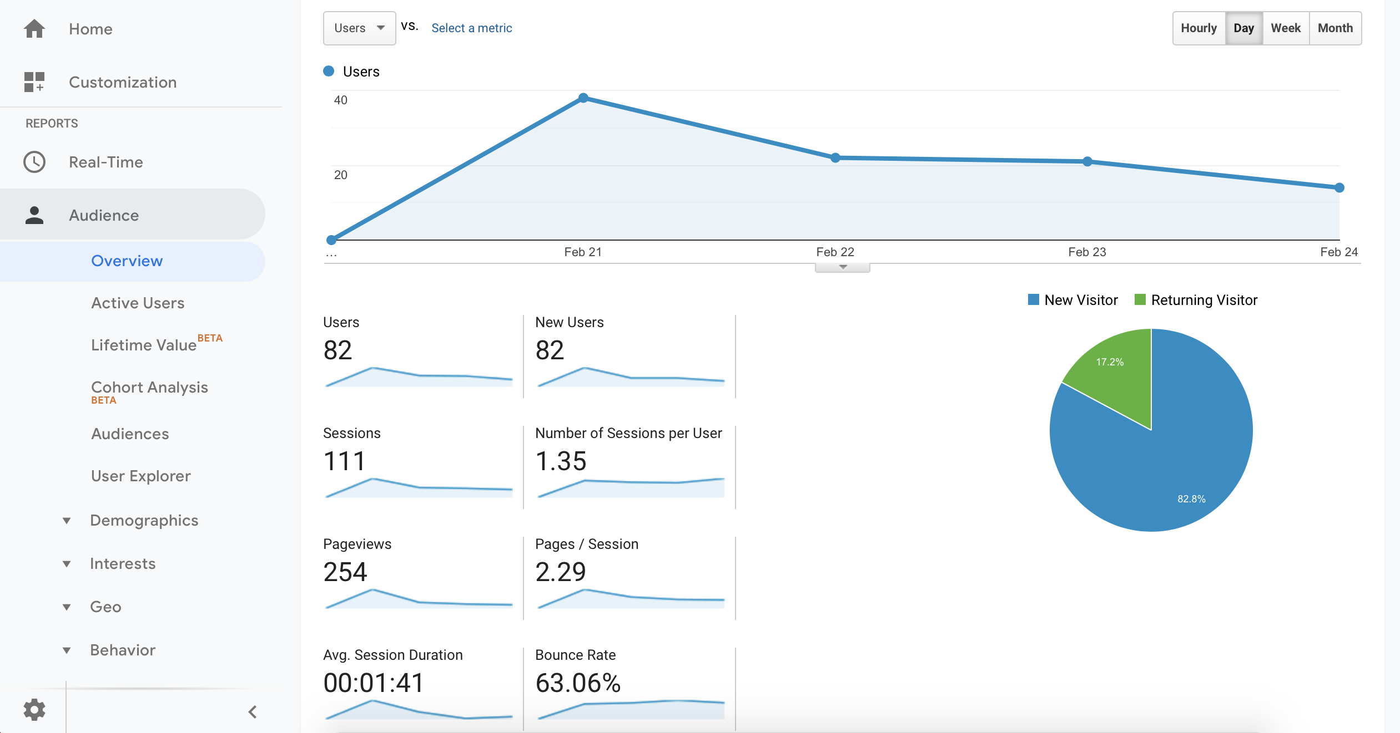
Audience overview

Slide 4
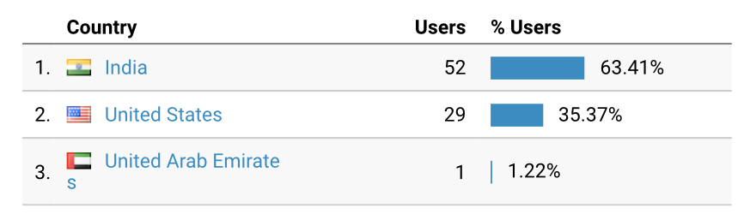
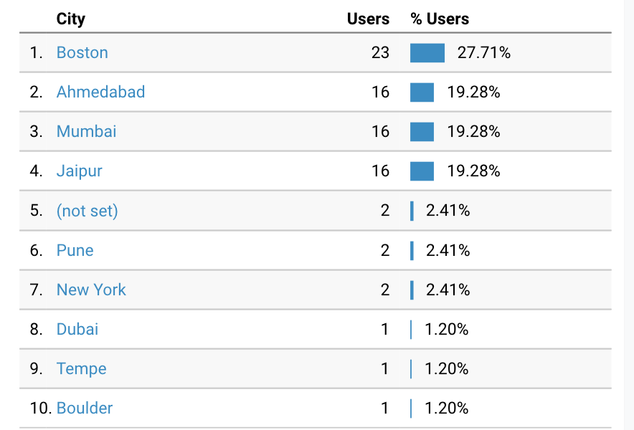
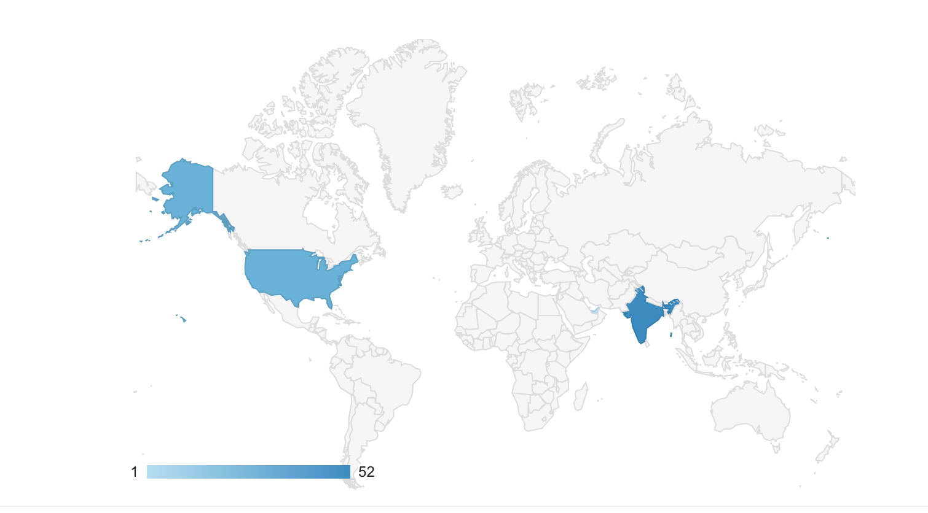
Location Analytics

Slide 5
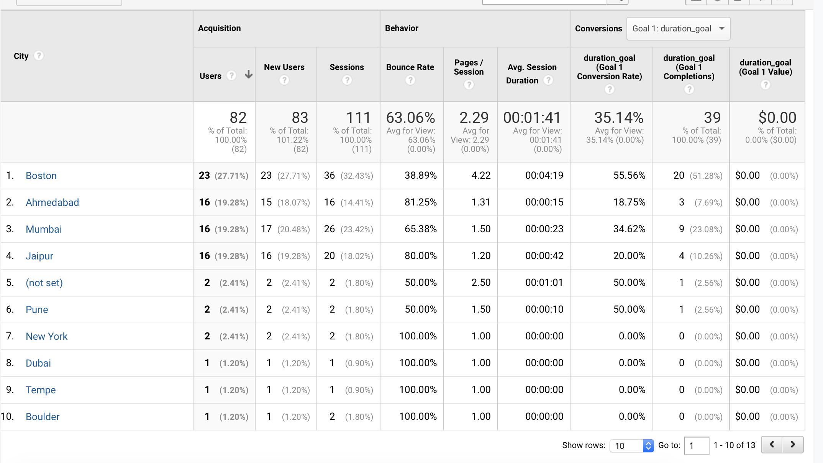
Location Analytics

Slide 6
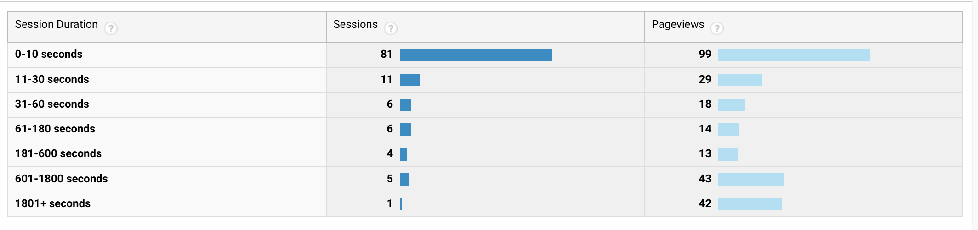
Duration of view

Slide 7
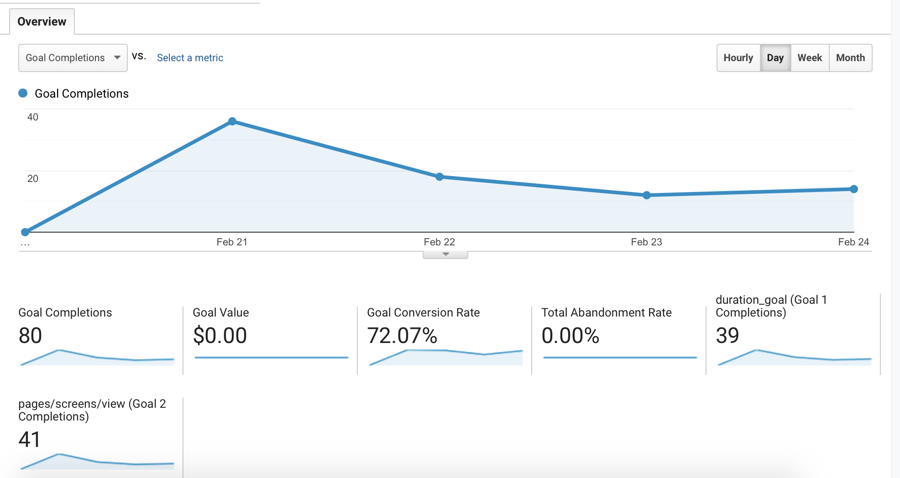
Goal (General)

Slide 8
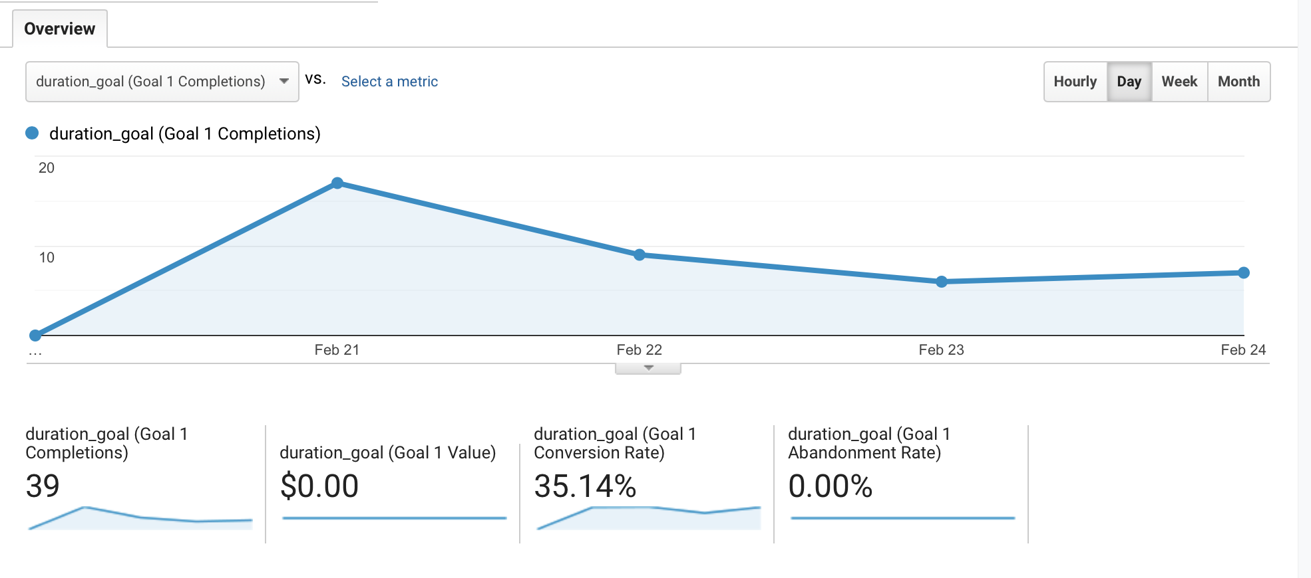
Goal 1 (duration>3 seconds)

Slide 9
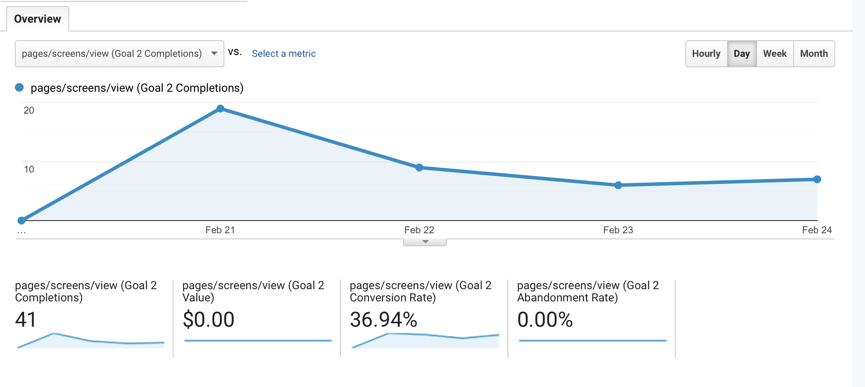
Goal 2 (Pages/Screens per session >= 2)

